Slide 1
Group 23
Team member:
Neha Ambekar Shriharsha
Radiah Tahsin Tanisha
Surbhi Hooda
Fabienne Yang
Ziqi Han
Mozi Li
Airbnb
Price Prediction

Slide 2


01
INTROUCTION
Help homeowners choose the best price.
How can we help Airbnb hosts to determine the optimum nightly price for their listings?
What are the various factors which affect the price of an Airbnb listing?
How does the accessibility to various amenities affect the price of Airbnb listings?
What are the various factors which affect the reviews?

Slide 3
DATA PROCESSING
02
Data Collection
Inside Airbnb
Data Cleaning
Clean free text columns and other columns which were out of scope
Data Wrangling/Manipulation
Create histogram to identify single value columns
Data Transformation
Transfrom data based on characteristics of the data

Slide 4
03
Neighborhood Selection
A Map that shows the relationship between price and location
Price Prediction Model
Comparison of machine learning models to predict prices
Feature Importance
DATA
ANALYSIS
We determine what features are the most important in determining the value of a listing.

Slide 5
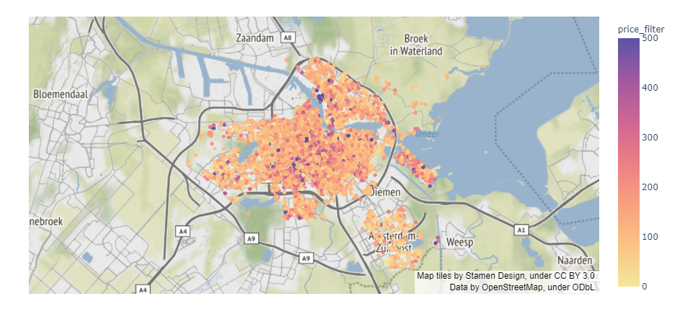
NEIGHBORHOOD SELECTION

Slide 6

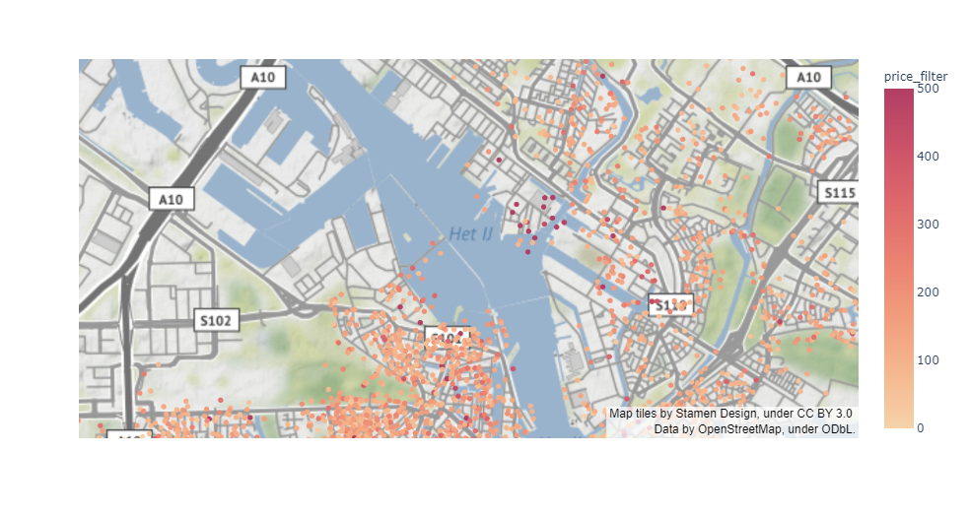

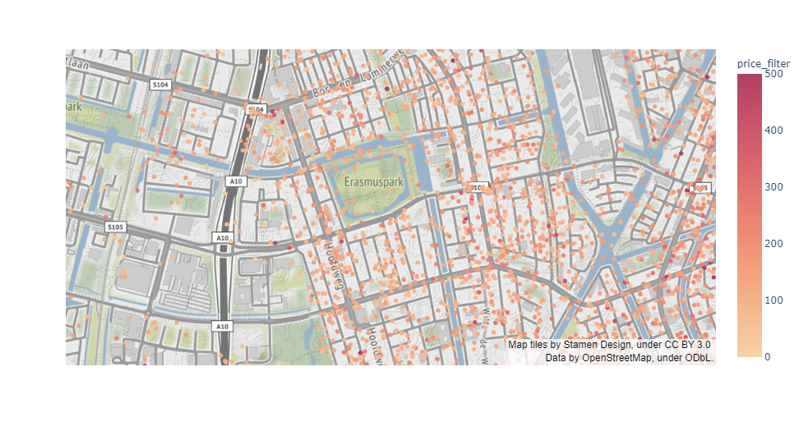
AMSTERDAM MARINA
ERASMUSPARK

Slide 7


STEP 1
Data
Pre-Processing
Correlation Analysis and Redundancies
STEP 2
Drop irrelevant features
STEP 3
Drop nan value
STEP 4
Outliers and Skewness detection
STEP 5
Encoding data with one-hot encoder

Slide 8
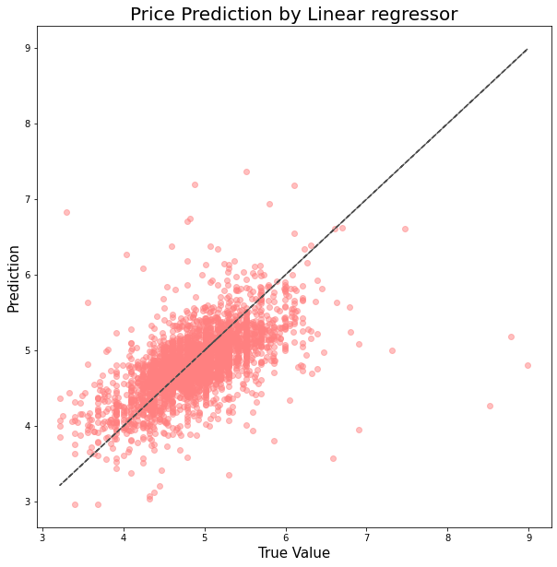
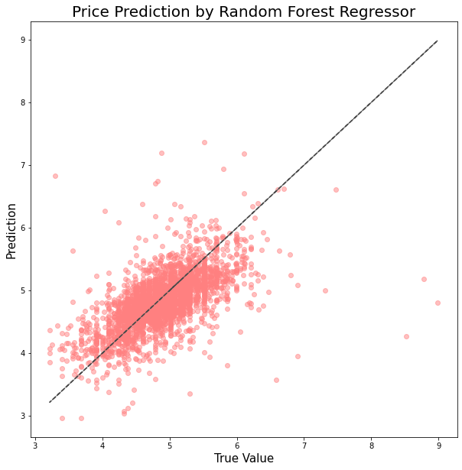
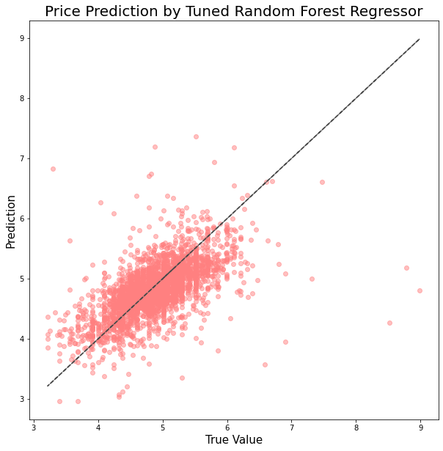

Model
Comparison
Linear
RMSE
0.38023
R2
0.47596
Random
Forest
RMSE
0.36818
R2
0.50867
compare different
models with parameters
Tuned
Random
Forest
RMSE
0.25055
R2
0.77686
Neural
Network
RMSE
0.42900
R2
0.49876

Slide 9
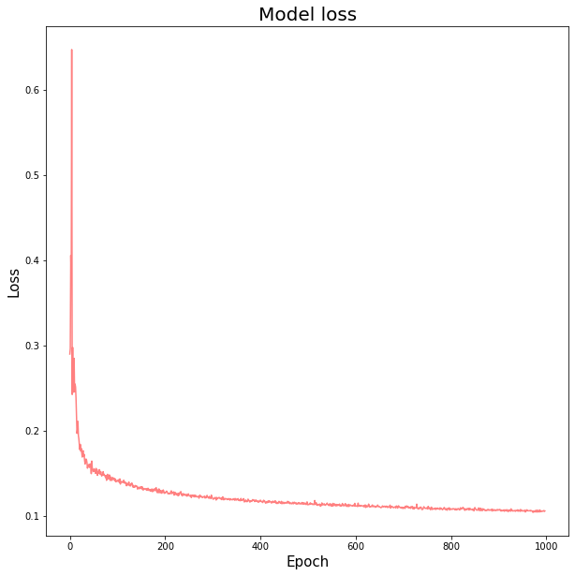
MODEL LOSS
07

Slide 10
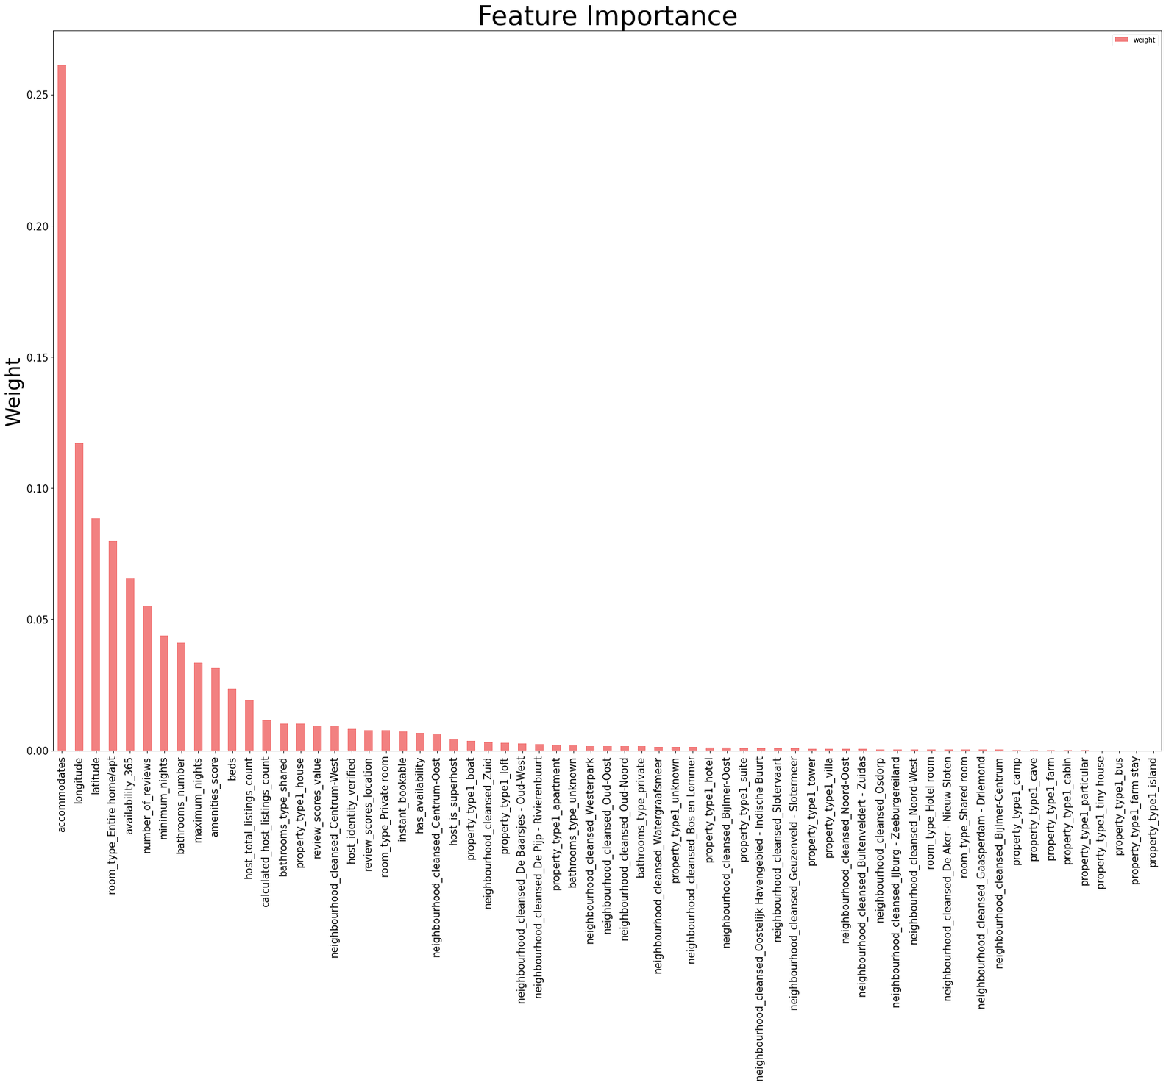
FEATURE IMPORTANCE

Slide 11
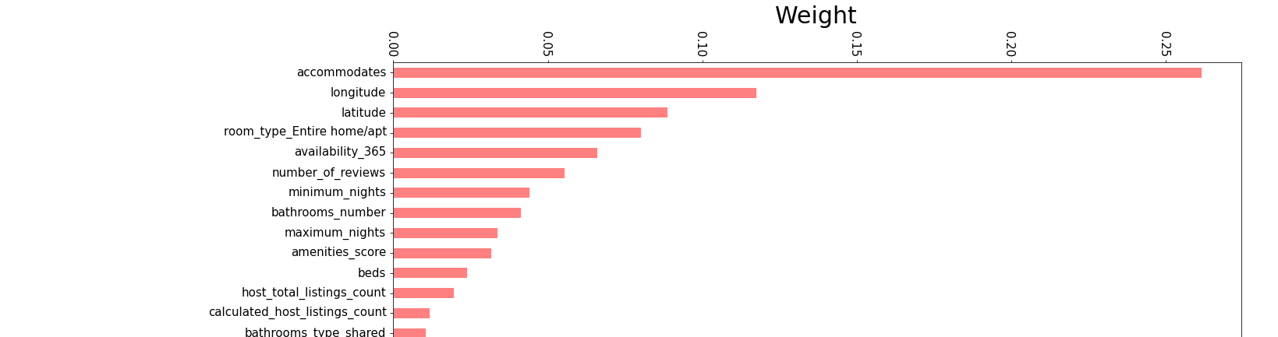
FEATURE IMPORTANCE

Slide 12

Capitalize on the locations in which rentals are high in demand
Increase number of offered amenities
Focus on the listing condition based on reviews
Use the Random Forest model for pricing as it's prediction error is the smallest
Use the neural network model for calculating pricing added parameters
CONCLUSION
www.reallygreatsite.com

